Slide 1
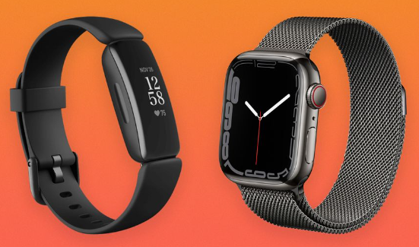
Fitness Trackers and Smartwatches

Slide 2
Data Analysts:
Azriel Manual Tamayo
Debra Mcnulty
Kelly Doyle
Robert Bellgraph

Slide 3
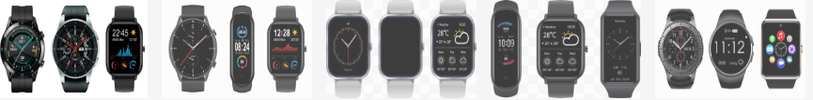
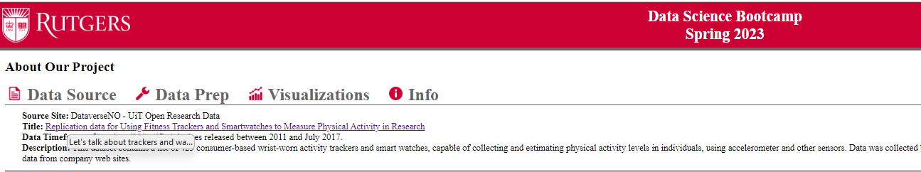
Let's talk about trackers and watches
What was the inspiration in choosing this data?
We originally wanted to find trackers/watches GPS information, with lots of details on how people’s fitness habits are structured and how these wonderful devices can help us see this picture.
As we were searching for data from all over the country with enough data satisfy the requirement, we found little data for the specific are of interest. Mainly gps and we found that this data may be more private than expected and fit our Ethics of data timeframe well. Being able to see mapping are close to people homes, well…. Was not avail.
We went with this dataset due to all the options, global data, per company, per country, making these different trackers and watches from all different.
The one thing about data as we quickly find, a little data can give us a lot of return and some data does not get used.
And we built a Dashboard to have a better understanding what we find in the data.
Notes:
Research Questions to Answer:
Plot 2019 - We start off with 1st question that was during the pandemic (COV-19), what’s the education cost during a pandemic time. Then we’re gonna compare that with the next slide.
----------------------
What’s the:
Where in the US can a family find the most Affordable education for a four-year undergrad education.
We present in out mapping both Privat and Public. 2 year and 4 year
2 year and 4 year
Can we see a true variance from the Covid Pandemic
Is Public In State or Out of Sate or Private schools more economical.
****** POSSIBLE NEEDS*****
2021 Bar - can we add color to the highest 5 and lowest and possibly add the dollars in the ends
Possible top by themselves
Questions on Data:

Slide 4
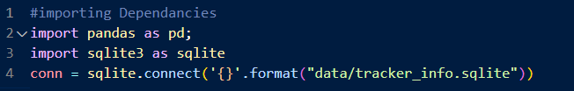

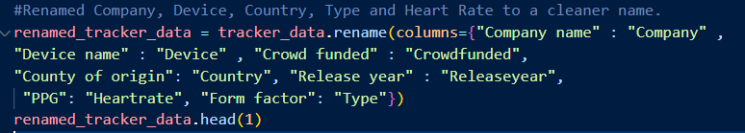

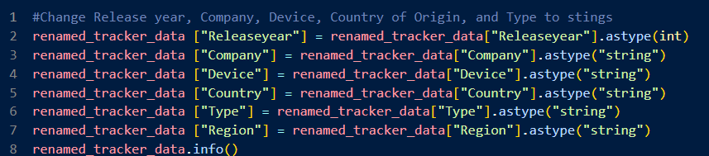


What we did with the data – Data Wrangling
We retrieved the data from the CRV File using Jupyter Notebooks/Numpy.
Changed column names, types, dropped all the nan, and merged a second Geo Data csv for leaflet map
Exported the file to SQLite where we used Flask to iterate over the data and export to JSON for use In building visuals.
Notes:
Research Questions to Answer:

Slide 5
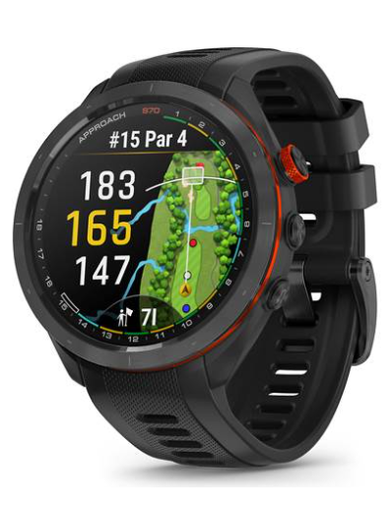
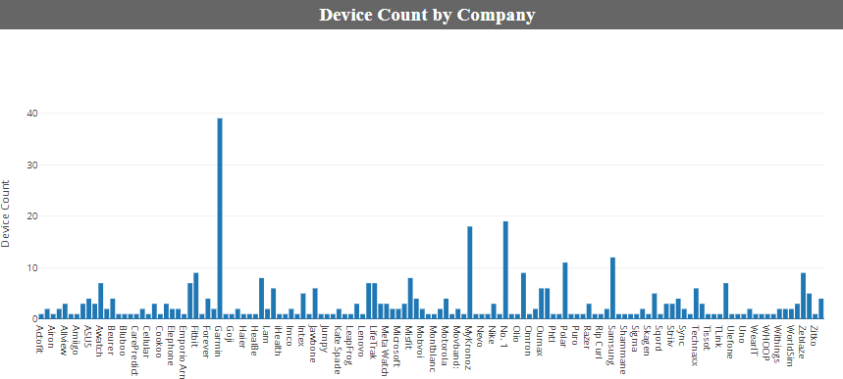
Device Count by Company
Based on chart, we can see the top businesses, Garmin leading with 39 devices in this given time
Apple didn’t come in until 2014-2016
Filter data by each company
No. 1 was actually number 2….
Notes:
Research Questions to Answer:

Slide 6
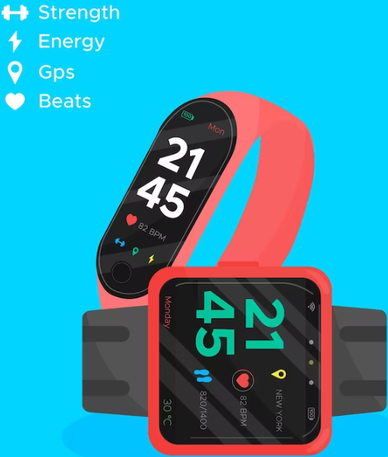
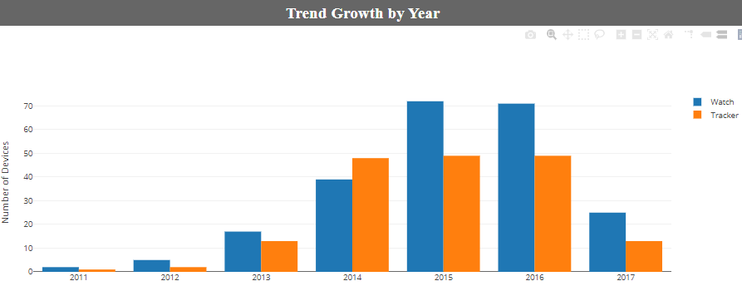
Trend Growth By Year
2013 started to grow
2014 made things popular
2015-16 was the peak
2017 only recorded half of the year
Watches dominated 2015-16
Notes:
Research Questions to Answer:

Slide 7
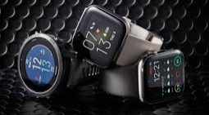
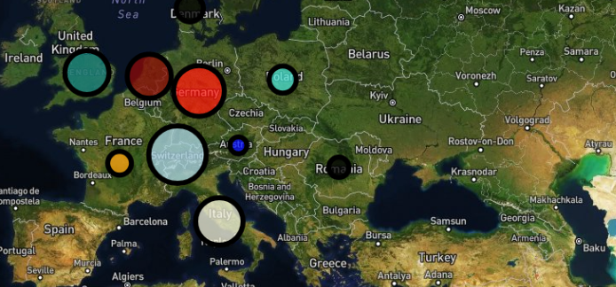
Global wearables map
What did we learn for this Data?
US dominated by nearly double the 2nd highest device producing country.
US almost evenly split between tracker devices and watches. Other countries have a much larger ratio of one to the other.
Asia-Pacific Region was heavier on the watch devices than the trackers.
Asia-Pacific has more watch devices developed than US, despite the US lead in tracking devices total
What do we wish to learn more from this Data?
Have more time to see the options on each device
Find out what options are highest production
Find other options offered since 2017
See where the trend lies now in 2023 and how COVID affect both production, sales and options for 2020-21

